Slide 1
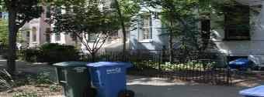
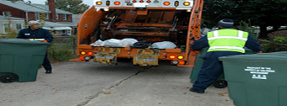
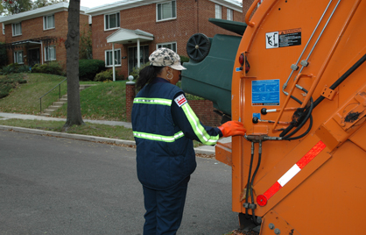
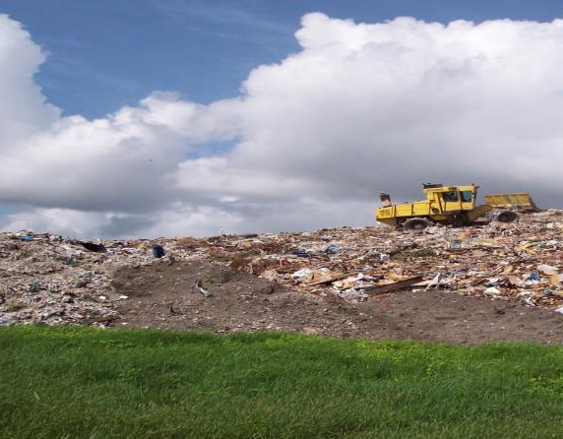

Solid Waste Management Options for the District of Columbia:
Sustainability-based Analytics
Solid Waste Management Consulting Services
Technical Proposal
Solicitation Doc97300
April 4, 2013

Slide 2
Today’s
Agenda
DCDPW State of Play
Strategic Direction
NCAM Model Use
Opportunities from Study Data and Results

Slide 3
Today’s
Take Away
  Now is the opportunity to re-think and re-structure the flow and management of solid materials reflecting a systematic, integrated approach to managing capital and the environment.
  The District must make informed decisions on choosing a resource management system and operations design that can secure value and return to the DC economy and its citizens in the form of jobs, cost control, renewable energy, energy resiliency, and technological advancement

Slide 4
State of Play
  DCDPW Moving Ahead to Incorporate the Mayor’s Sustainability Plan and Goals in Operational Strategy and Planning
    Zero Waste to Landfills
    Waste Generation reduced by 15%
    20% reuse of Construction/Demolition Material
    80% Diversion of waste from landfills
    50% reduction in Greenhouse Gases
    50% Increase in Renewable Energy
    Recast materials as reusable and extract asset value
    Ensure capacity and capability for population growth

Slide 5
State of Play
With no solid waste processing capacity of its own, the District of Columbia is outsourcing the management of valuable residual assets, and paying to do so (tipping fees, etc, with expiring contracts)
To meet the Mayor’s Sustainability program goals and long-term needs, DPW is identifying environmentally preferable and cost-effective methods for disposition that reward DC first
Emphasis on recycling has a politically correct feel with little empirical evidence of financial or environmental validity.
The primary focus on traditional recycling options may be foreclosing technology and processes that contribute to multiple goals and targets across the DC Sustainability spectrum

Slide 6
DCDPW Strategic Direction
What is the strategy for managing the District of Columbia’s solid waste over the next 30 years that is:
  Fiscally responsible
  Responds to stakeholders’ priorities
  Addresses sustainable practices
  Uses the best technologies for the waste stream
Use both an environmental and financial lens to identify and quantify residual material handling options

Slide 7
Purpose of the Study
Develop an analytic framework to evaluate the highest and best use of air, land, water and money in selecting appropriate technologies and or process strategies to manage solid waste over the next thirty years
Understand and integrate community priorities
Identify technology and process options that contribute to the full spectrum of DC Sustainability targets and challenges

Slide 8
The Sustainable Basis for Decision-Making
Usable supplies of Air, Land and Water are Shrinking Due to Regulation, Conservation and Development
The District Benefits by Environmentally and Financially Managing Usable Air, Land and Water as Assets
Natural Capital Asset Management (NCAM) Inventories Used and Reserved Air, Land Water Capacity as Asset with Operational and Potential Market Value.
These values are the basis of the quantitative analysis applied to current and potential waste management system options to determine the best deal for the District.
Enables Optimization Decision-Making, rather than Compliance or Avoidance Decision-Making

Slide 9
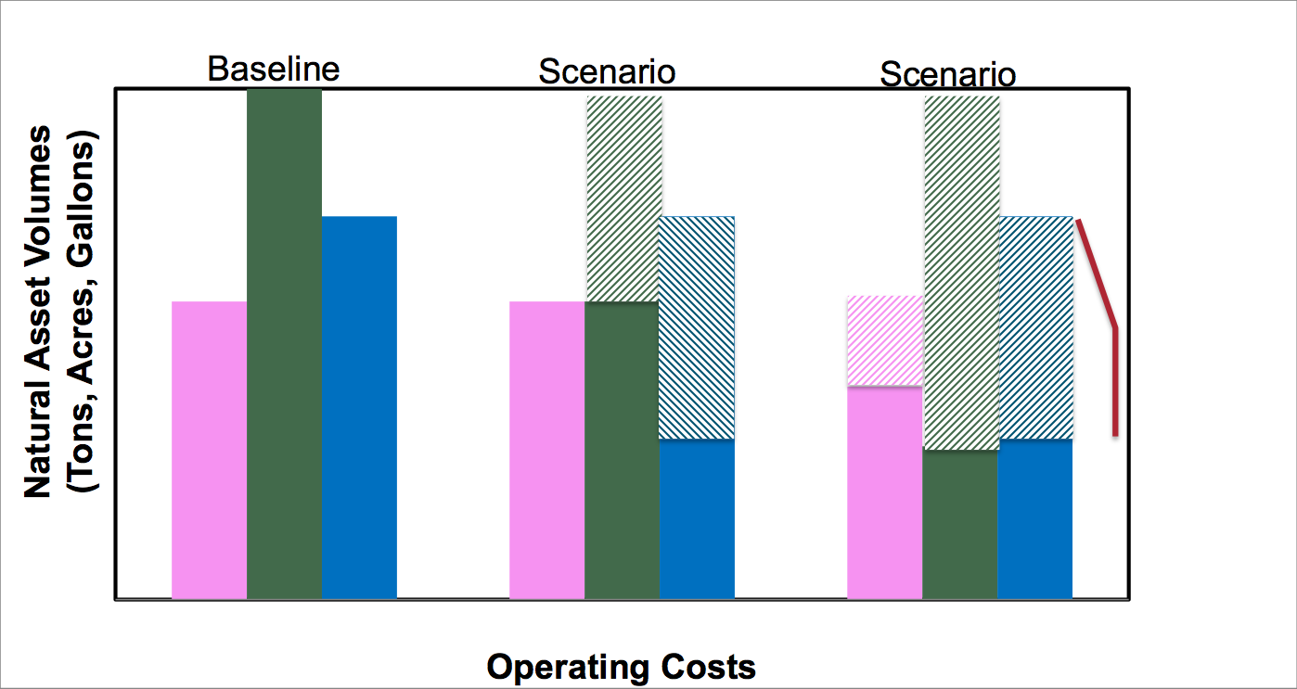
NCAMTM EVALUATION ILLUSTRATIVE RESULT
Possible Sale Transfer, use in other Economic or Social Enterprise
 | Air
 | Land
 | Water
 | Air Saved
 | Land Saved
 | Water Saved

Slide 10
Opportunities from Study Data and Results
NCAM Study inputs and data will cross-cut with other agencies such as DOE
Stakeholder Participation will likely be of political interest
Technology and process scenario options included for value generation contribute to all DC Sustainability Goals, not just DCDPW (E.g., bankable GHG credits, water use reductions, renewable energy production, reduced fuel use, neighborhood energy sourcing)
Results and Recommendations will identify potential asset, development, offset, financial, and credit market values from all aspects of waste management (reduction to disposition) associated with DCDPW technology and process decision-making as current contracts expire.

